Slide 1
Assessing Validity of UFO Sightings
Group 18:
Colman Dekker,
Ryosuke Kato,
Kirsten Winter,
Ran YAn

Slide 2
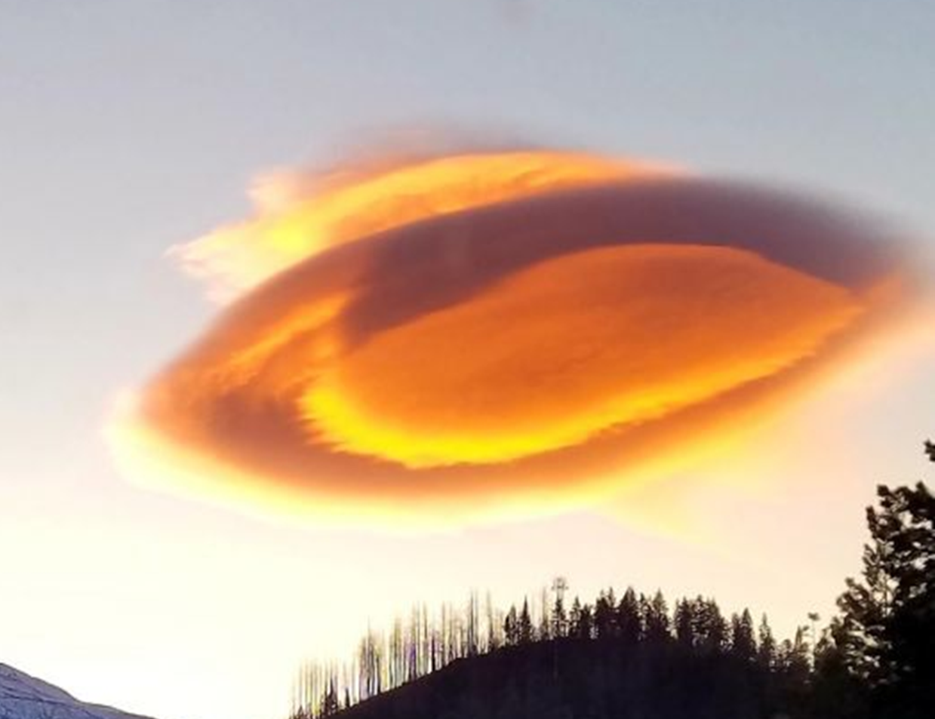
Motivation
Public interest in UFO research rising
Popular in media: Storm Area 51
What causes false sightings?
Does our data indicate a possible valid event?
Notes:
Picture from Mt. Shasta, MT lenticular cloud Feb 12th. [1] https://www.foxnews.com/tech/ufo-aliens-mount-shasta-california-weather

Slide 3
Methodology
Grouped data
Investigated outliers for validity
Reassessed grouping of data
Compared data to most valid outlier

Slide 4
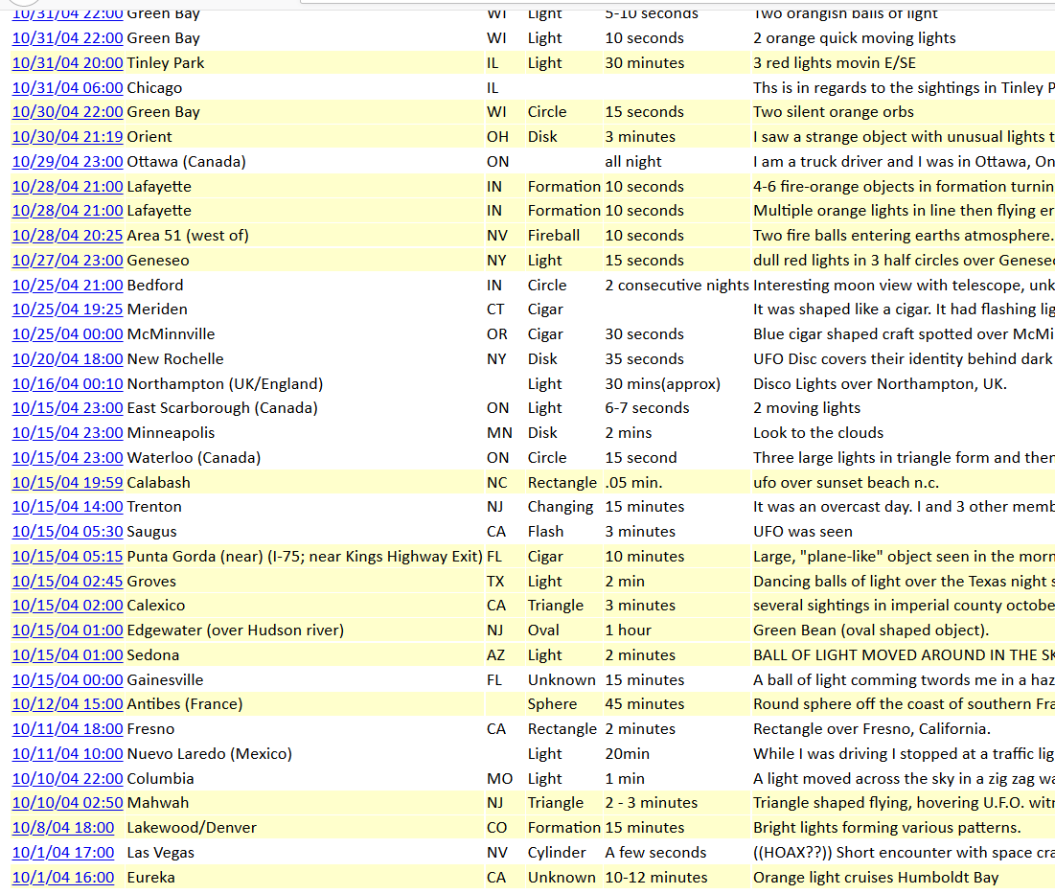
Data Overview
Kaggle open dataset
~80,000 individual UFO sightings from 1900-2014
Original data from NUFORC
Notes:
[2] https://www.kaggle.com/NUFORC/ufo-sightings#scrubbed.csv
[3] http://www.nuforc.org/

Slide 5
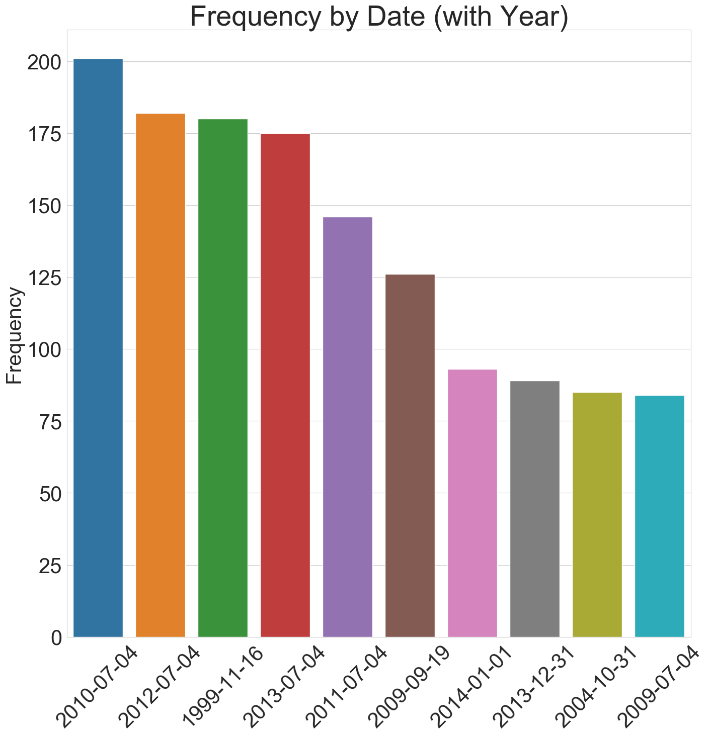
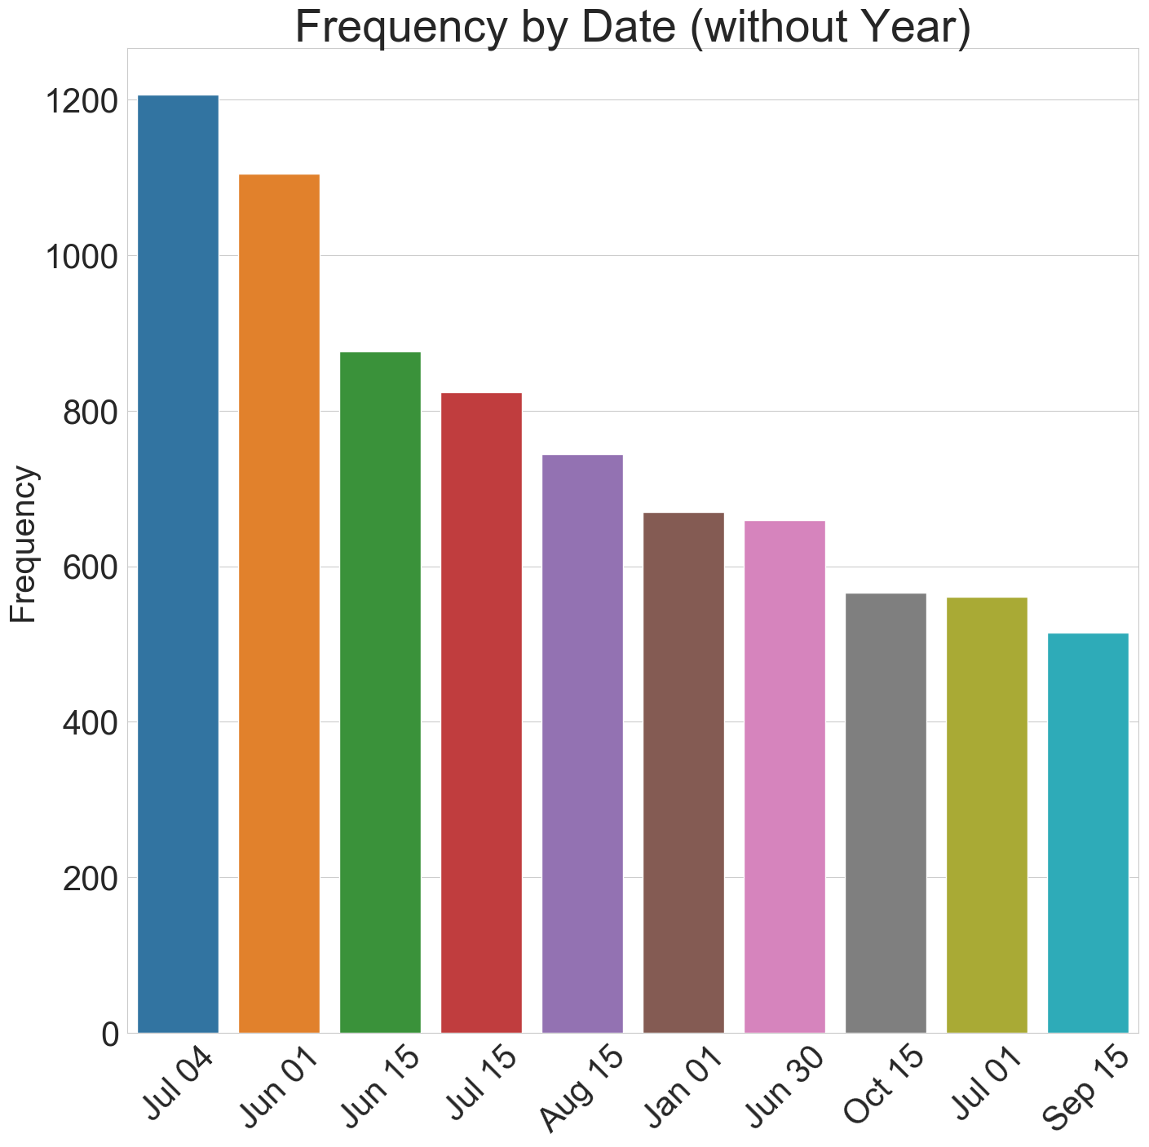
Frequency by Date (US)

Slide 6
Frequency by Date (US)

Slide 7
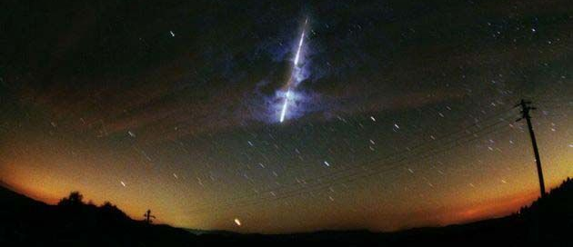
Leonids Meteor Shower Nov 16, 1999
Notes:
[4] https://www.space.com/13654-photos-leonid-meteor-shower-skywatchers.html

Slide 8
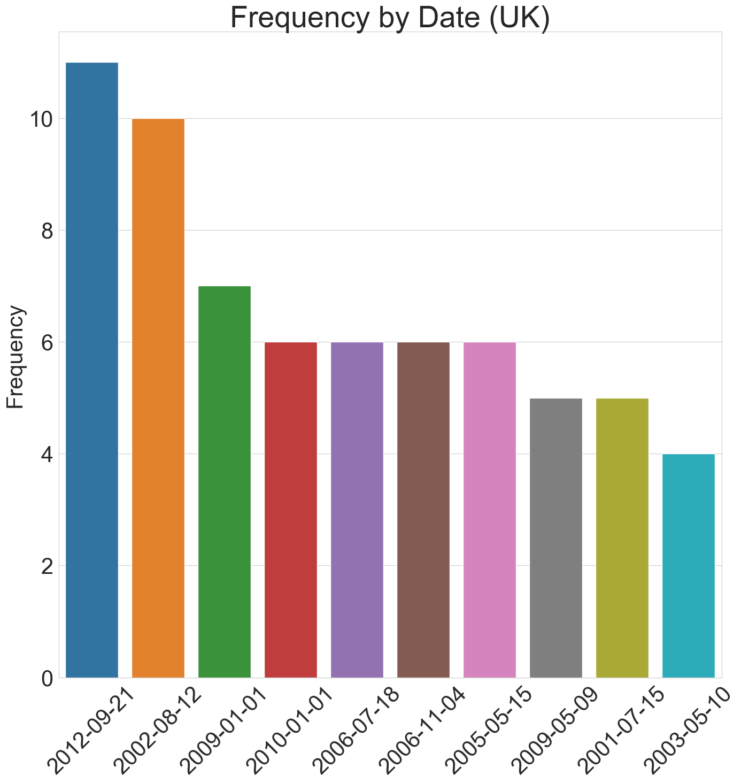
Frequency by Date Comparison to UK

Slide 9
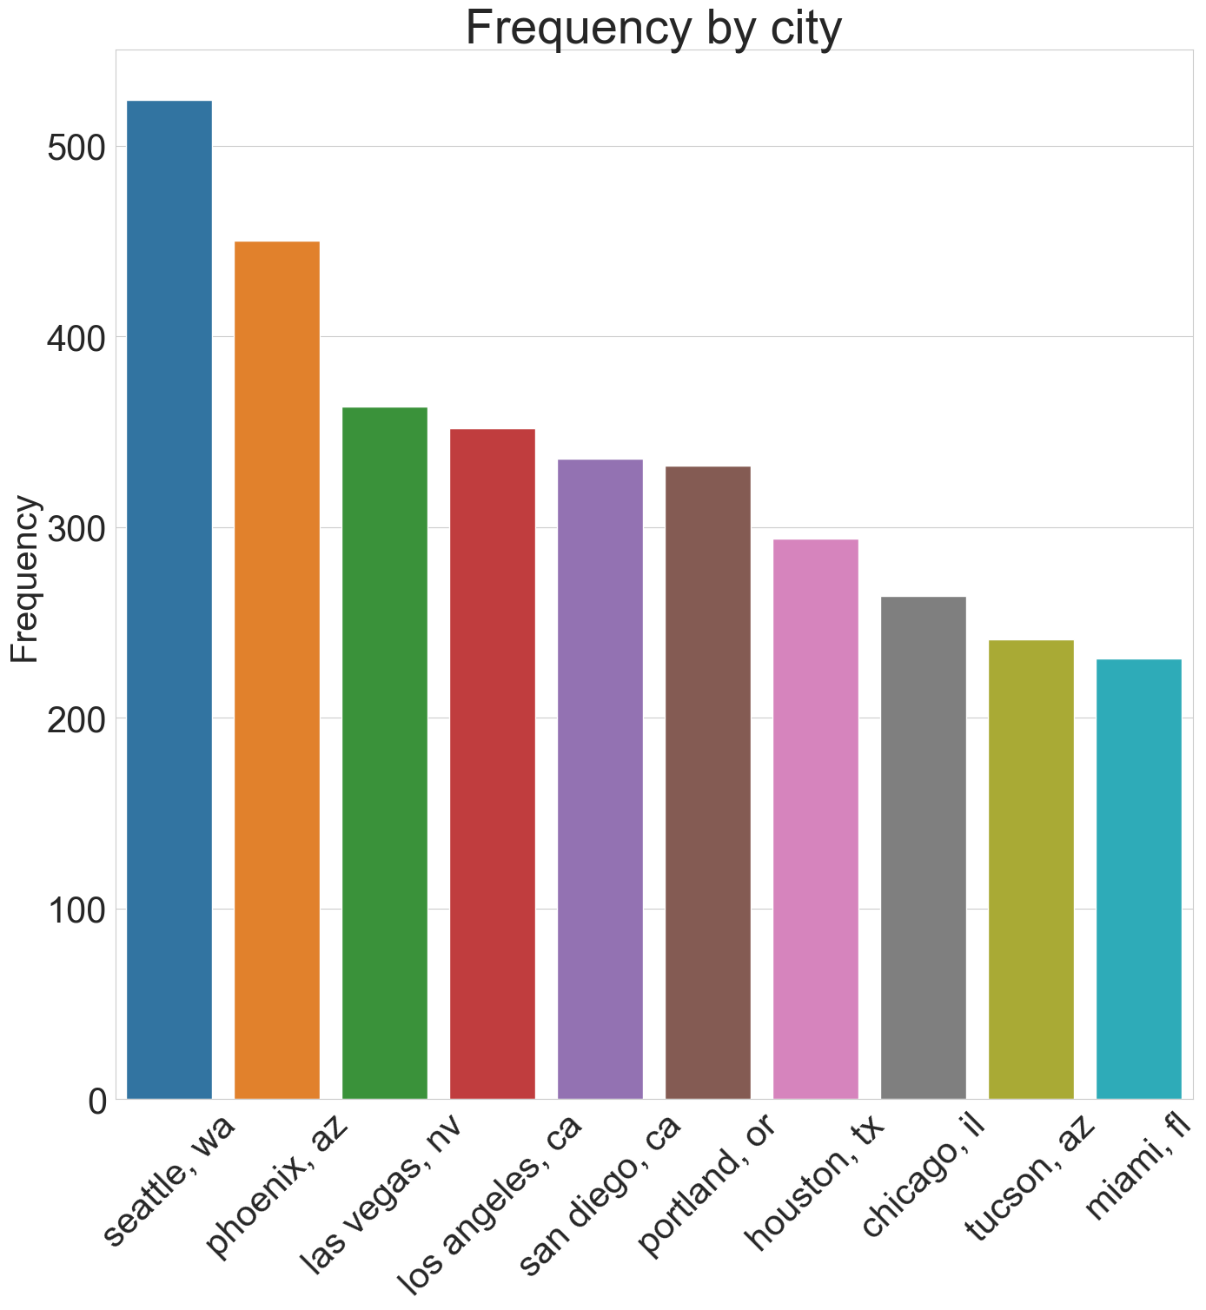
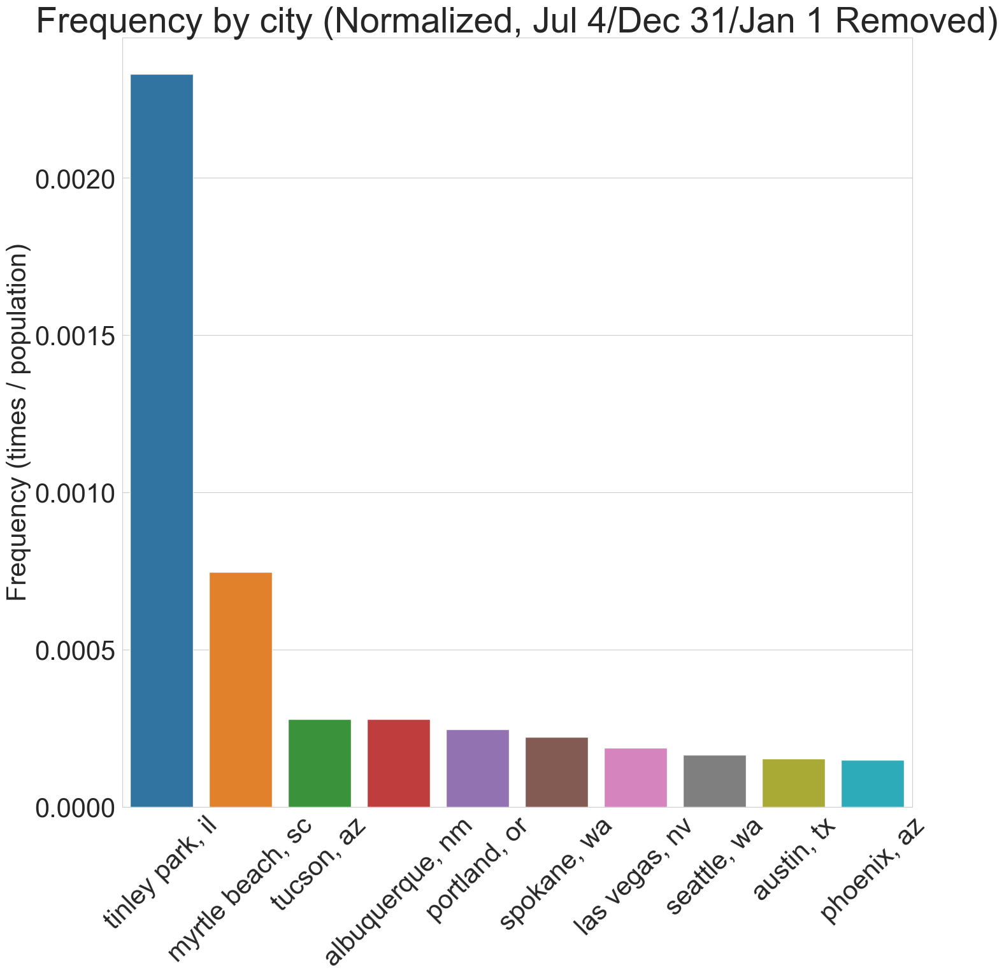
Comparison of Top Cities

Slide 10
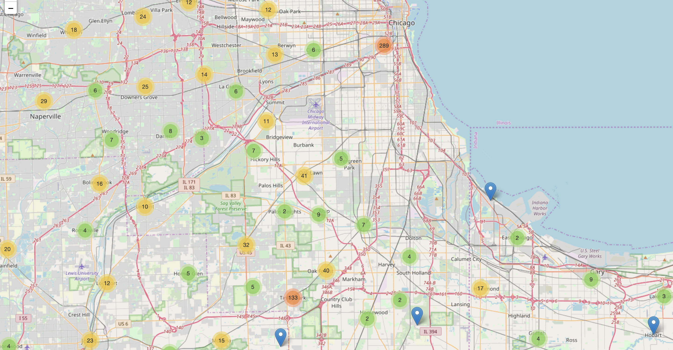
289
Chicago Metro Area
133

Slide 11
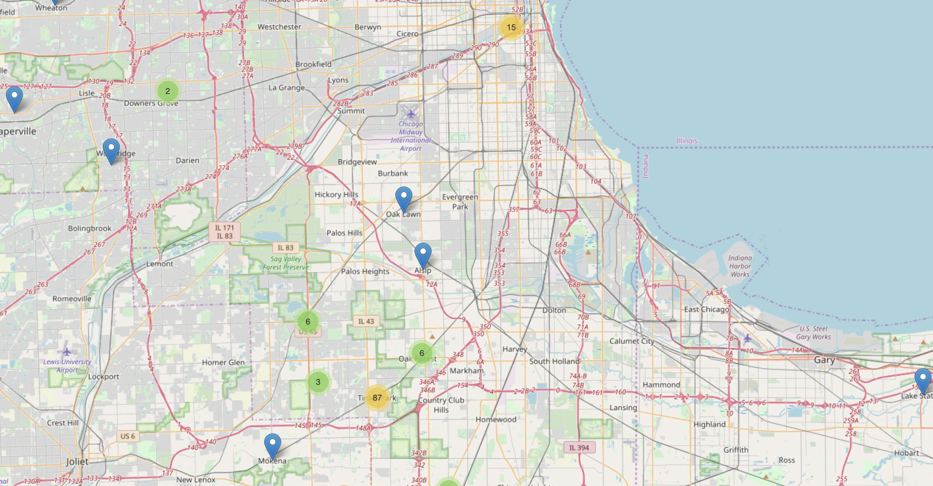
15
Chicago Metro Area:
2004 Data
87

Slide 12
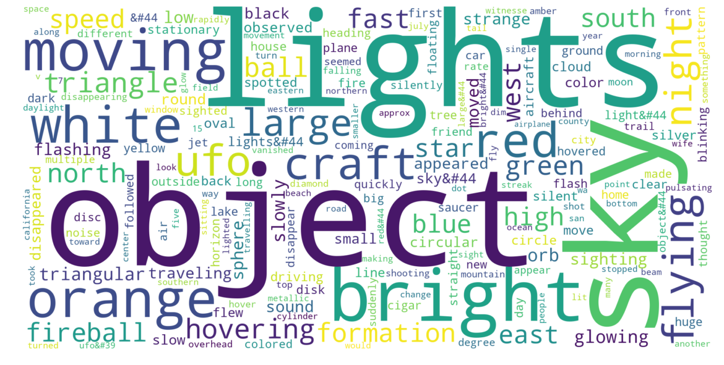
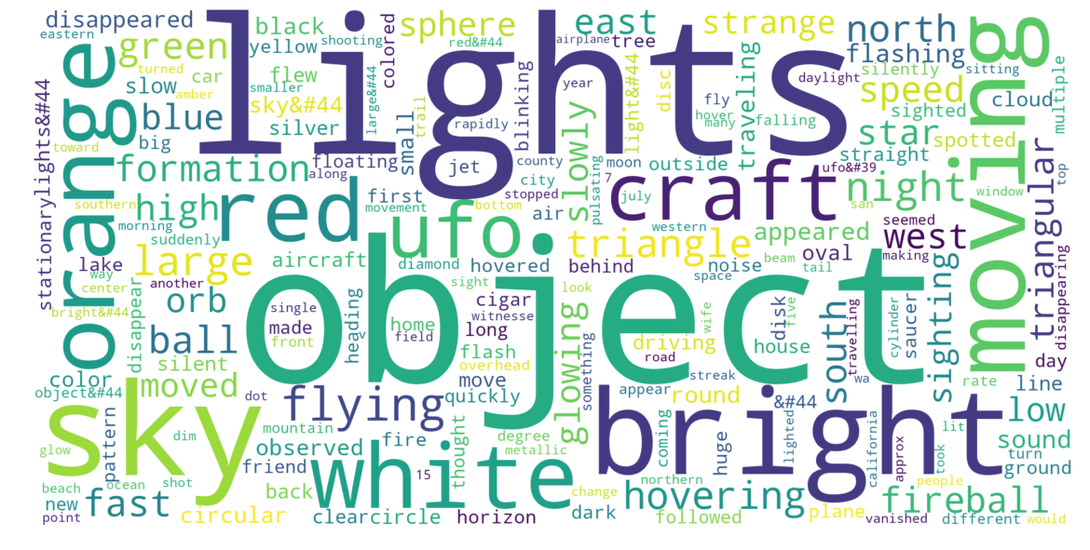
Recorded Description of Sighting
Tinley Park Recorded Description of Sighting

Slide 13
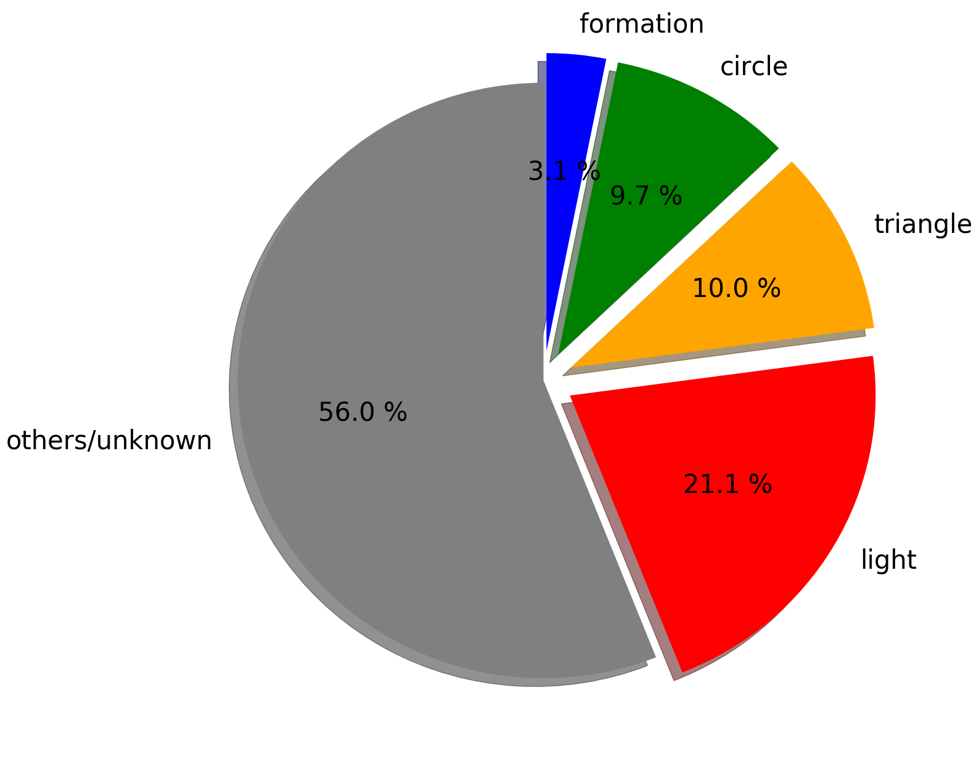
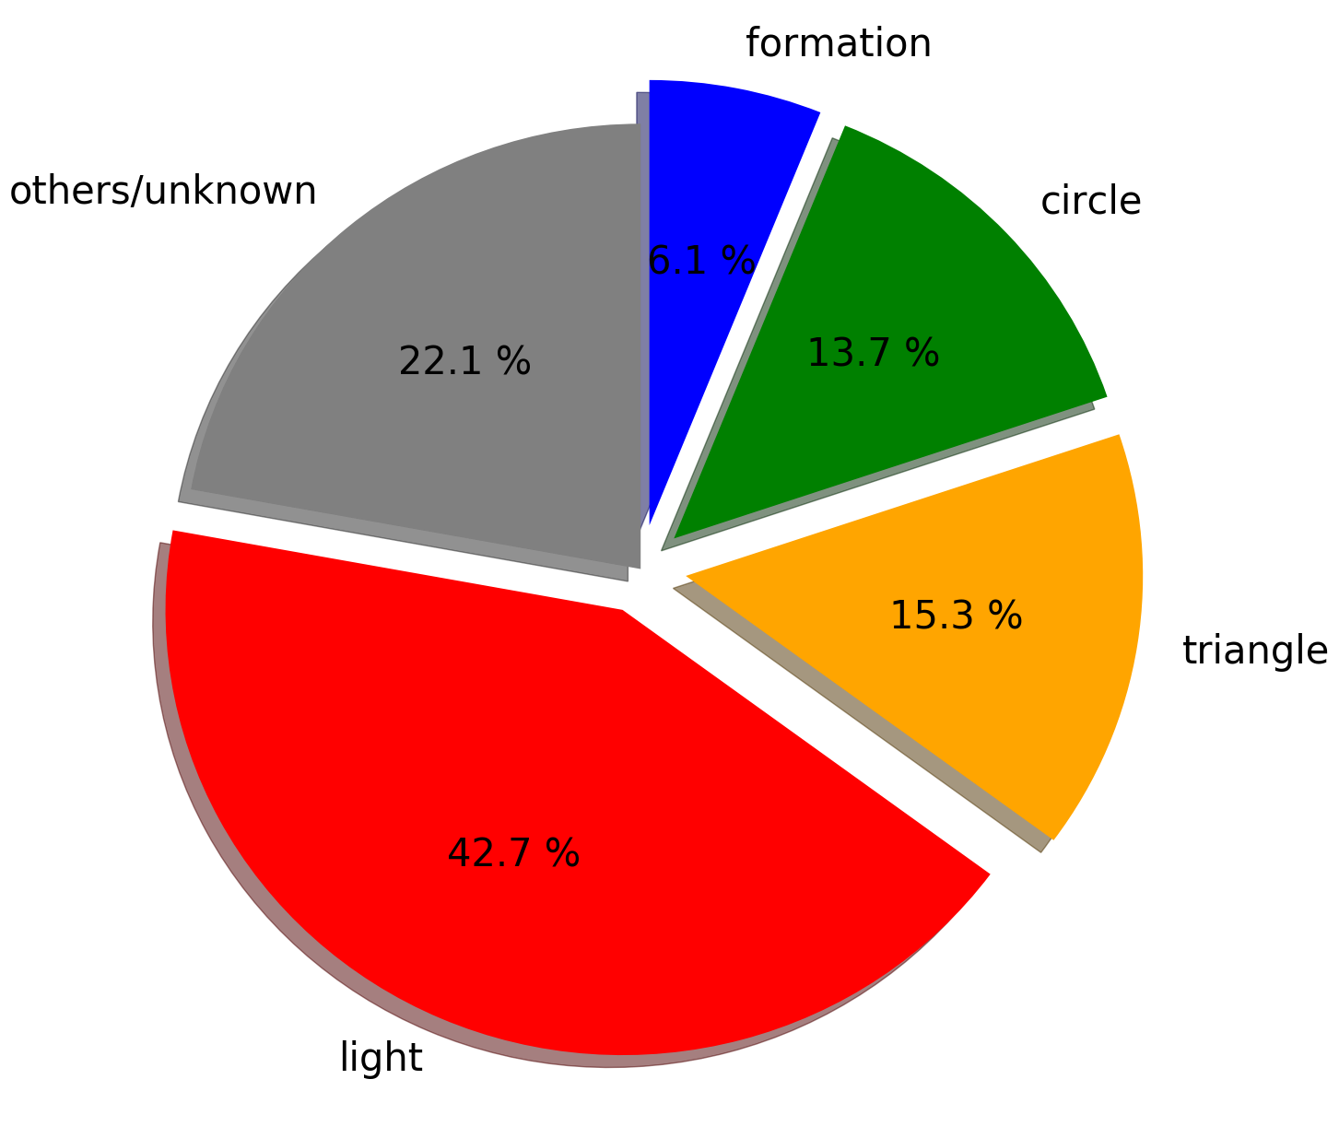
Shape (all Data)
Shape (Tinley Park)

Slide 14
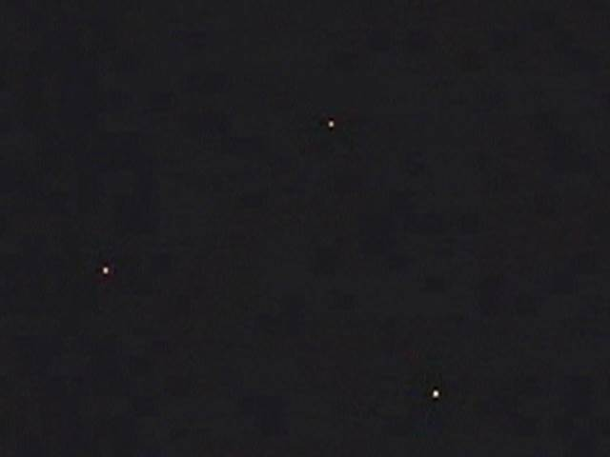
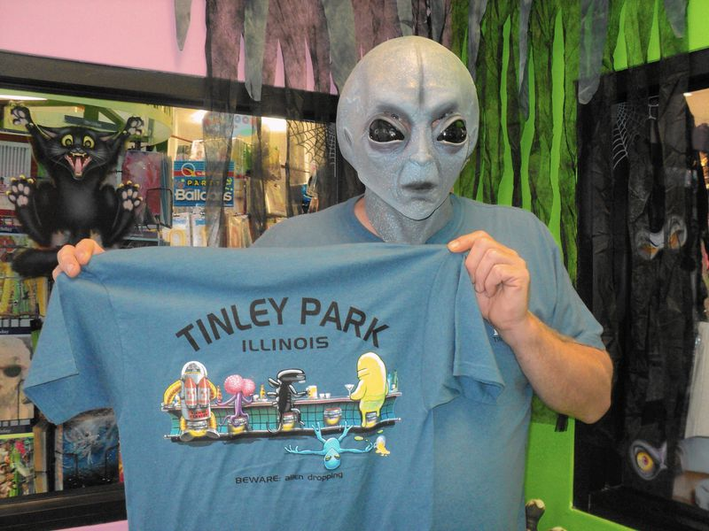
Tinley Park
Famous for UFO sightings
UFO Hunters episode on this location
Related to USS Nimitz sightings
Notes:
[5] http://www.nbcnews.com/video/dateline/24641217
[6] https://www.chicagotribune.com/suburbs/daily-southtown/ct-stc-dekker-column-st-0924-20150922-story.html

Slide 15
Conclusion
Likely false sightings
Most likely event
Holidays with fireworks
Astronomical events
Tinley Park
US Navy
Many similar descriptions

Slide 16

Thank you!

Slide 17
Sources
https://www.foxnews.com/tech/ufo-aliens-mount-shasta-california-weather
https://www.kaggle.com/NUFORC/ufo-sightings#scrubbed.csv
http://www.nuforc.org/
https://solarsystem.nasa.gov/asteroids-comets-and-meteors/meteors-and-meteorites/leonids/in-depth/
https://www.space.com/13654-photos-leonid-meteor-shower-skywatchers.html
http://www.nbcnews.com/video/dateline/24641217
https://www.chicagotribune.com/suburbs/daily-southtown/ct-stc-dekker-column-st-0924-20150922-story.html

